Slide 1
Adding audio files to the CodeX
An extension for Mission 5

Slide 2
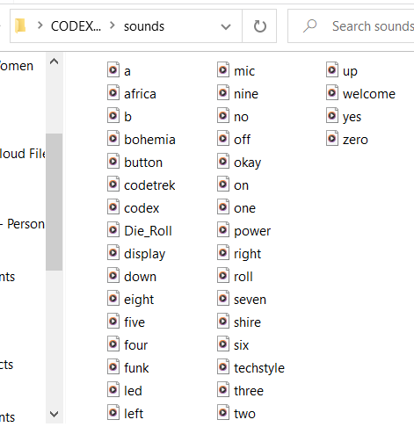
Adding audio files to the Codex
The CodeX comes with many audio clips pre-loaded. You can see them from the CodeX drive.

Slide 3
Adding audio files
You can add audio files to your CodeX folder. Just follow these steps.
Download (or create) an audio file that is in mp3 format
Here is one website you can use: https://pixabay.com/sound-effects/
https://pixabay.com/music/

Slide 4
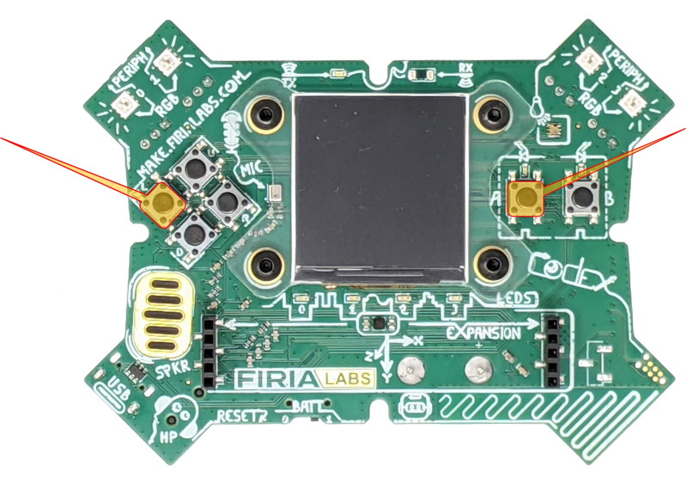
Adding audio files -- watch the video
2. Put your CodeX into USB-writeable mode (youtube video demonstration)
Make sure the CodeX is connected to your computer
Press and hold the L and A buttons and keep holding them down

Slide 5
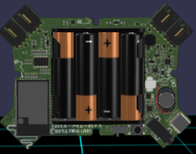
Adding audio files -- step-by-step instructions
2. Put your CodeX into USB-writeable mode
c. Reach around and briefly press the RESET button (press and release)

Slide 6
Adding audio files -- step-by-step instructions
2. Put your CodeX into USB-writeable mode
d. Keep holding buttons A and L until you see the red LEDs light up from 3 to 0 in right-to-left order.
e. You will see a double-flash of ALL red LEDs to confirm the filesystem is in USB-writable mode.

Slide 7
Adding audio files -- step-by-step instructions
2. Put your CodeX into USB-writeable mode
f. Now release L and A.
g. You are ready to upload your files to the Codex

Slide 8
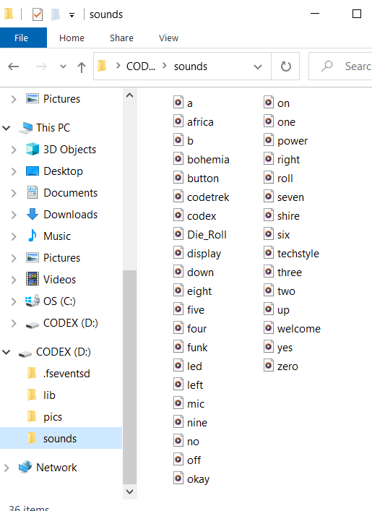
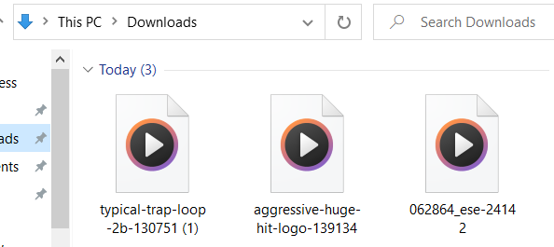
Adding audio files
3. Upload your audio files to the CodeX
Open your CodeX folder for sounds and drag your audio file(s) into the folder.

Slide 9
Adding audio files
4. Make the CodeX unwritable again by disconnecting it from the computer and then connecting again.
5. Use the audio commands you have learned to play the audio files added to the CodeX
Audio file name here

